Slide 1
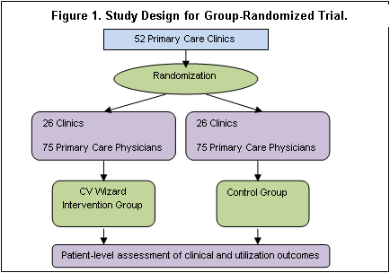
SMI Wizard: RCT to Reduce CV Risk
Cluster-randomized clinical trial that includes 50+ primary care clinics (150 PCPs, 2250 adults with SMI) at HP, EH & PN blocked within organization and randomly assigned 1:1 to SMI Wizard or control arms

Slide 2
SMI Wizard: Partner Sites
HealthPartners
Rebecca Rossom, PI
JoAnn Sperl-Hillen, Co-I
Patrick O’Connor, Co-I
Kris Ohnsorg, PM
Lauren Crain, Co-I
Amy Boelter, RA
Rashmi Sharma, Epic Programmer
Deepa Appana, Web Programmer
Essentia
Steve Waring, Site PI
Joseph Bianco, Co-I
Allise Taran, Site PM
Paul Hitz, Programmer
Lisa Wilkinson, Epic Programmer
Park Nicollet
Kris Kopski, MD, PhD, Co-I
Jeanine Rosner, MPH Co-I
Olga Godlevsky, Programmer
Vijay Thirumalai, Programmer
Prasad Pasumarthi, Programmer
Consultants:
Russell Luepker, Ben Druss

Slide 3
SMI Wizard : Aims
Primary Aim: Determine whether adults with SMI receiving care in intervention clinics will have, compared to those receiving care in control clinics:
Hypothesis 1: Lower total modifiable CV risk
Hypothesis 2: Better control of specific modifiable risk factors:
BP, Lipids, Obesity, A1c, Smoking, Aspirin Use
Hypothesis 3: Lower rates of prescriptions for obesogenic SMI
medications at 12 months post-index
Secondary Aim: Explore impact on CV risk factor identification, treatment initiation/intensification, adherence, outpatient/inpatient utilization, risky prescribing events, CV events

Slide 4
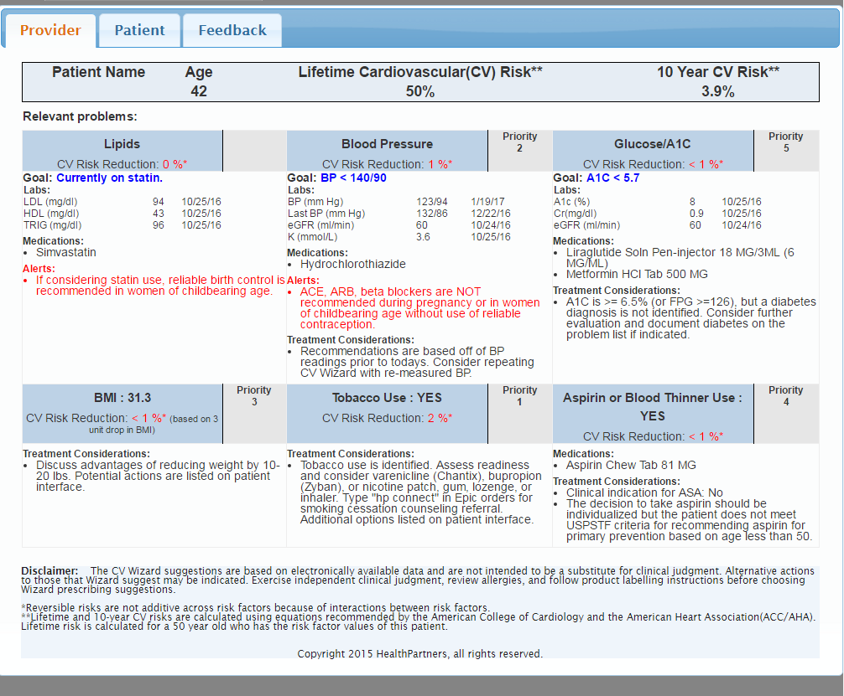
RCT to Reduce CV Risk in Adults with SMI: Provider Sheet

Slide 5
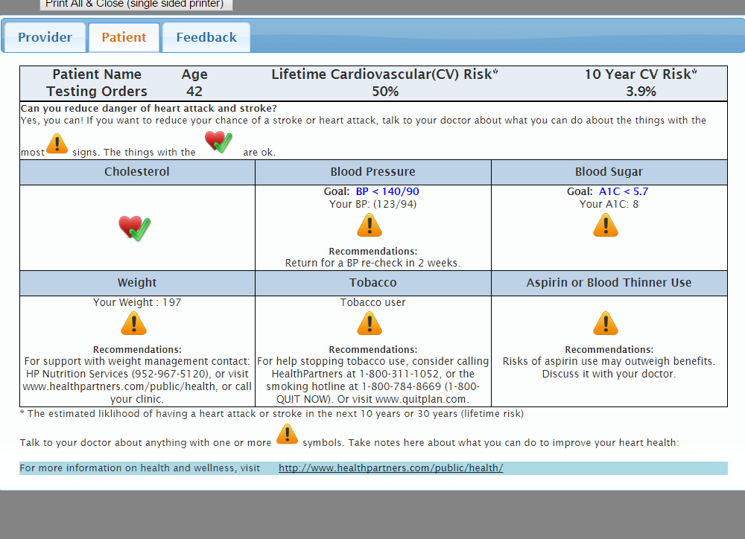
RCT to Reduce CV Risk in Adults with SMI: Patient Sheet

Slide 6
